Slide 1

PYTHON PROGRAMMING & DATA SCIENCE
Hyper Parameter Tuning

Slide 2
Hyper Parameter Tuning
Difference between parameter and hyperparameter:
Model parameters: These are the parameters that are estimated by the model from the given data. For example the weights of a deep neural network.
Model hyper parameters: These are the parameters that cannot be estimated by the model from the given data. These parameters are used to estimate the model parameters. For example, the learning rate in deep neural networks.

Slide 3
Hyper Parameter Tuning
What is hyperparameter tuning ?
Hyperparameter tuning is the process of determining the right combination of hyperparameters that allows the model to maximize model performance. Setting the correct combination of hyperparameters is the only way to extract the maximum performance out of models.

Slide 4
Hyper Parameter Tuning
Choosing good hyperparameters:
Choosing the right combination of hyperparameters is not an easy task. There are two ways to set them.
Manual hyperparameter tuning: In this method, different combinations of hyperparameters are set (and experimented with) manually. This is a tedious process and cannot be practical in cases where there are many hyperparameters to try.
Automated hyperparameter tuning: In this method, optimal hyperparameters are found using an algorithm that automates and optimizes the process.

Slide 5
Hyper Parameter Tuning
Hyperparameter tuning methods
In this section, I will introduce all of the hyperparameter tuning methods that are popular today.
Random Search
In the random search method, we create a grid of possible values for hyperparameters. Each iteration tries a random combination of hyperparameters from this grid, records the performance, and lastly returns the combination of hyperparameters which provided the best performance.
Grid Search
In the grid search method, we create a grid of possible values for hyperparameters. Each iteration tries a combination of hyperparameters in a specific order. It fits the model on each and every combination of hyperparameter possible and records the model performance. Finally, it returns the best model with the best hyperparameters.

Slide 6
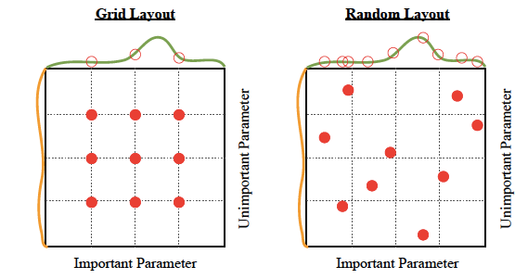
Hyper Parameter Tuning

Slide 7
Hyper Parameter Tuning
Bayesian Optimization
Tuning and finding the right hyperparameters for your model is an optimization problem. We want to minimize the loss function of our model by changing model parameters. Bayesian optimization helps us find the minimal point in the minimum number of steps. Bayesian optimization also uses an acquisition function that directs sampling to areas where an improvement over the current best observation is likely.
Tree-structured Parzen estimators (TPE)
The idea of Tree-based Parzen optimization is similar to Bayesian optimization. Instead of finding the values of p(y|x) where y is the function to be minimized (e.g., validation loss) and x is the value of hyperparameter the TPE models P(x|y) and P(y). One of the great drawbacks of tree-structured Parzen estimators is that they do not model interactions between the hyper-parameters. That said TPE works extremely well in practice and was battle-tested across most domains.

Slide 8
Hyper Parameter Tuning
Hyperparameter tuning algorithms
These are the algorithms developed specifically for doing hyperparameter tuning.
Hyperband
Hyperband is a variation of random search, but with some explore-exploit theory to find the best time allocation for each of the configurations. You can check this research paper for further references.
Population-based training (PBT)
This technique is a hybrid of two most commonly used search techniques: Random Search and manual tuning applied to Neural Network models.
PBT starts by training many neural networks in parallel with random hyperparameters. But these networks aren’t fully independent of each other.
It uses information from the rest of the population to refine the hyperparameters and determine the value of hyperparameter to try. You can check this article for more information on PBT.

Slide 9
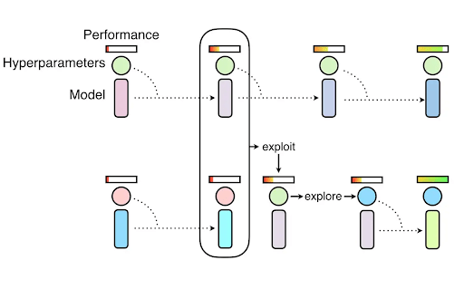
Hyper Parameter Tuning
BOHB
BOHB (Bayesian Optimization and HyperBand) mixes the Hyperband algorithm and Bayesian optimization. You can check this article for further reference.

Slide 10
Hyper Parameter Tuning
Tools for hyperparameter optimization
Now that you know what are the methods and algorithms let’s talk about tools, and there are a lot of those out there.
Some of the best Hyperparameter Optimization libraries are:
Scikit-learn (grid search, random search)
Hyperopt
Scikit-Optimize
Optuna
Ray.tune

Slide 11
Hyper Parameter Tuning
Scikit learn
Scikit-learn has implementations for grid search and random search and is a good place to start if you are building models with sklearn.
For both of those methods, scikit-learn trains and evaluates a model in a k fold cross-validation setting over various parameter choices and returns the best model.
Specifically:
Random search: with randomsearchcv runs the search over some number of random parameter combinations
Grid search: gridsearchcv runs the search over all parameter sets in the grid
Tuning models with scikit-learn is a good start but there are better options out there and they often have random search strategy anyway.

Slide 12
Hyper Parameter Tuning
Scikit-optimize
Scikit-optimize uses Sequential model-based optimization algorithm to find optimal solutions for hyperparameter search problems in less time.
Scikit-optimize provides many features other than hyperparameter optimization such as:
store and load optimization results,
convergence plots,
comparing surrogate models

Slide 13
Hyper Parameter Tuning
Hyperparameter tuning resources and examples
In this section, I will share some hyperparameter tuning examples implemented for different ML and DL frameworks.
Random forest
Understanding Random forest hyperparameters
Bayesian hyperparameter tuning for random forest
Random forest tuning using grid search

Slide 14
THANK YOU

